Slide 1
Data Science Technique and Real-
World Applications
Data Acquisition
Dr. Zahra Sharafi
https://sites.google.com/view/zahrasharafi/home
Email: z.sharafi@fs.de
1
Notes:
1

Slide 2
Agenda
How data is born
APIs
Excercise: Reddit Stock and Crypto tracker analysis
Web Scraping
Data Acquisition
Create Data
Obtain data
Preparation
Wrangling
Visualisation
Answering Questions
Statistical methods
ML
...
EDA
Web scraping
2

Slide 3
Data Acquisitions:
Data needed for an analysis:
Collected exclusively for the purpose of the analysis at hand
A survey
E.g., Amazon mTurk, SurveyMonkey, …
Experiment results
Designed via an application
One should consider:
Sample selection bias
Ethical aspects
Collected for other purposes by a third party
A subset of a bigger dataset
Data comes with more missing values (need for complementation)
Subscription is required or free to public
Access:
Bulk Download (E.g., in CSVs from CRSP, Compustat,…) with a direct link
Application program interfaces (APIs)
Collecting web data
Hand collection
Web scraping
3

Slide 4
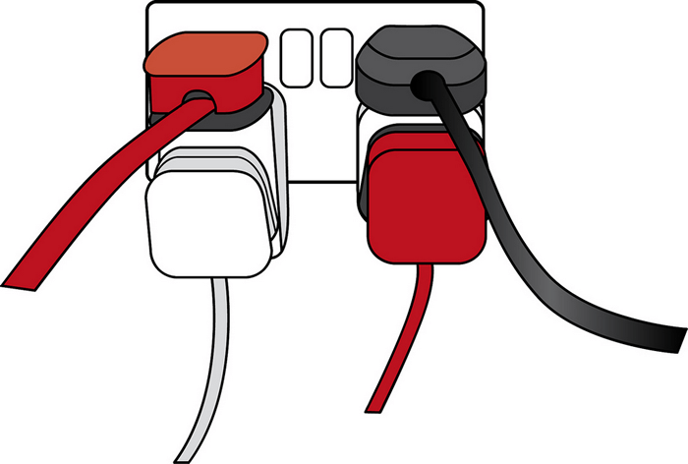
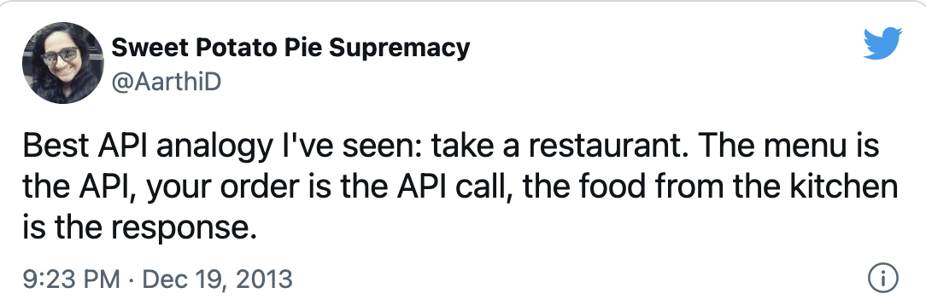
APIs:
Application Programming Interfaces
allow developers to create complex functionality more easily.
They abstract more complex code away from you, providing some easier syntax to use in its place.
There are countless APIs around to make your life easier
You created a device which needs electricity:
The Plug in your apartments is an API
You don’t need to take care of:
How electricity is generated
How it is transferred to your home
…
Source: https://developer.mozilla.org/en-US/docs/Learn/JavaScript/Client-side_web_APIs/Introduction
4

Slide 5
APIs:
Assume you want to predict stock returns based on weather conditions (Hirshleifer & Shumway, 2003 JF):
You don’t need to measure conditions yourself!
You rely on a weather API and request the data that you need
Example: https://openweathermap.org/
You focus on your own application/model
Source: https://www.smashingmagazine.com/2019/01/api-based-platforms-product-managers/
5
Notes:
Work with netword in chrome
Read json
Read wget

Slide 6
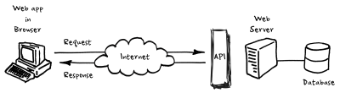
APIs:
Requests:
Get: used for fetching documents, could be cashed, won’t change anything in the server
Post: used for updating data, not cashed, no limit, could change something in the server
Security?
Responses:
200+ means the request has succeeded;
300+ means the request is redirected to another URL;
400+ means an error that originates from the client application has occurred;
500+ means an error that originates from the server has occurred.
GET | The API looks for the data you’ve requested and sends it back to you.
POST | The API creates a new entry in the database and tells you whether the creation is successful.
PUT | The API updates an entry in the database and tells you whether the update is successful.
DELETE | The API deletes an entry in the database and tells you whether the deletion is successful.
Source: https://www.smashingmagazine.com/2019/01/api-based-platforms-product-managers/
6
Notes:
Work with netword in chrome
Read json
Read wget
Maximum URL length is 2083 characters

Slide 7
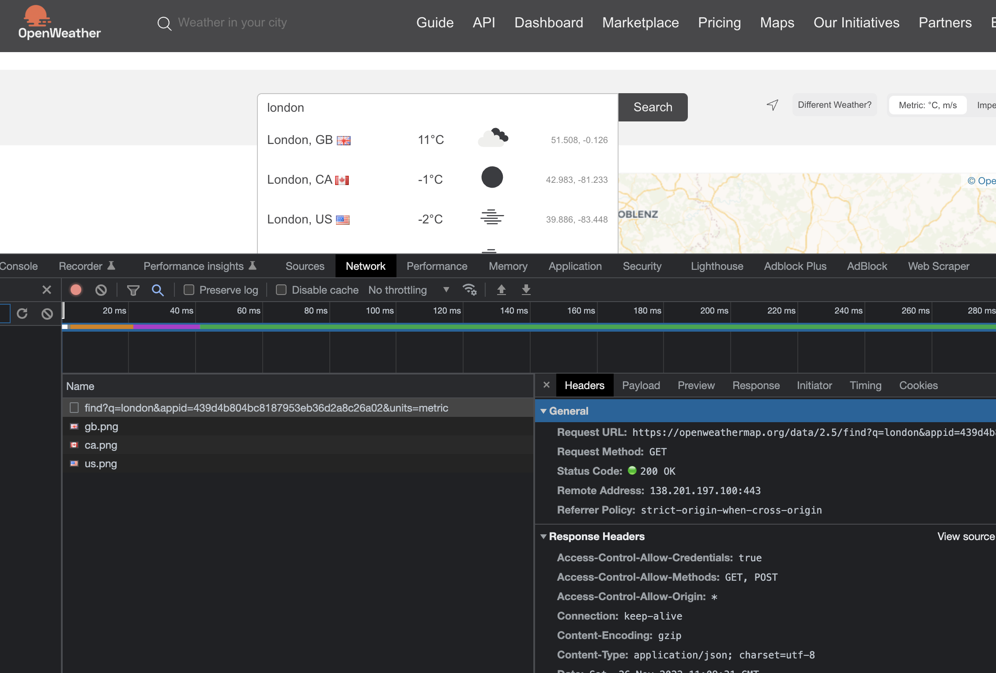
Example get request:
7
Notes:
Work with netword in chrome
Read json
Read wget
Maximum URL length is 2083 characters

Slide 8
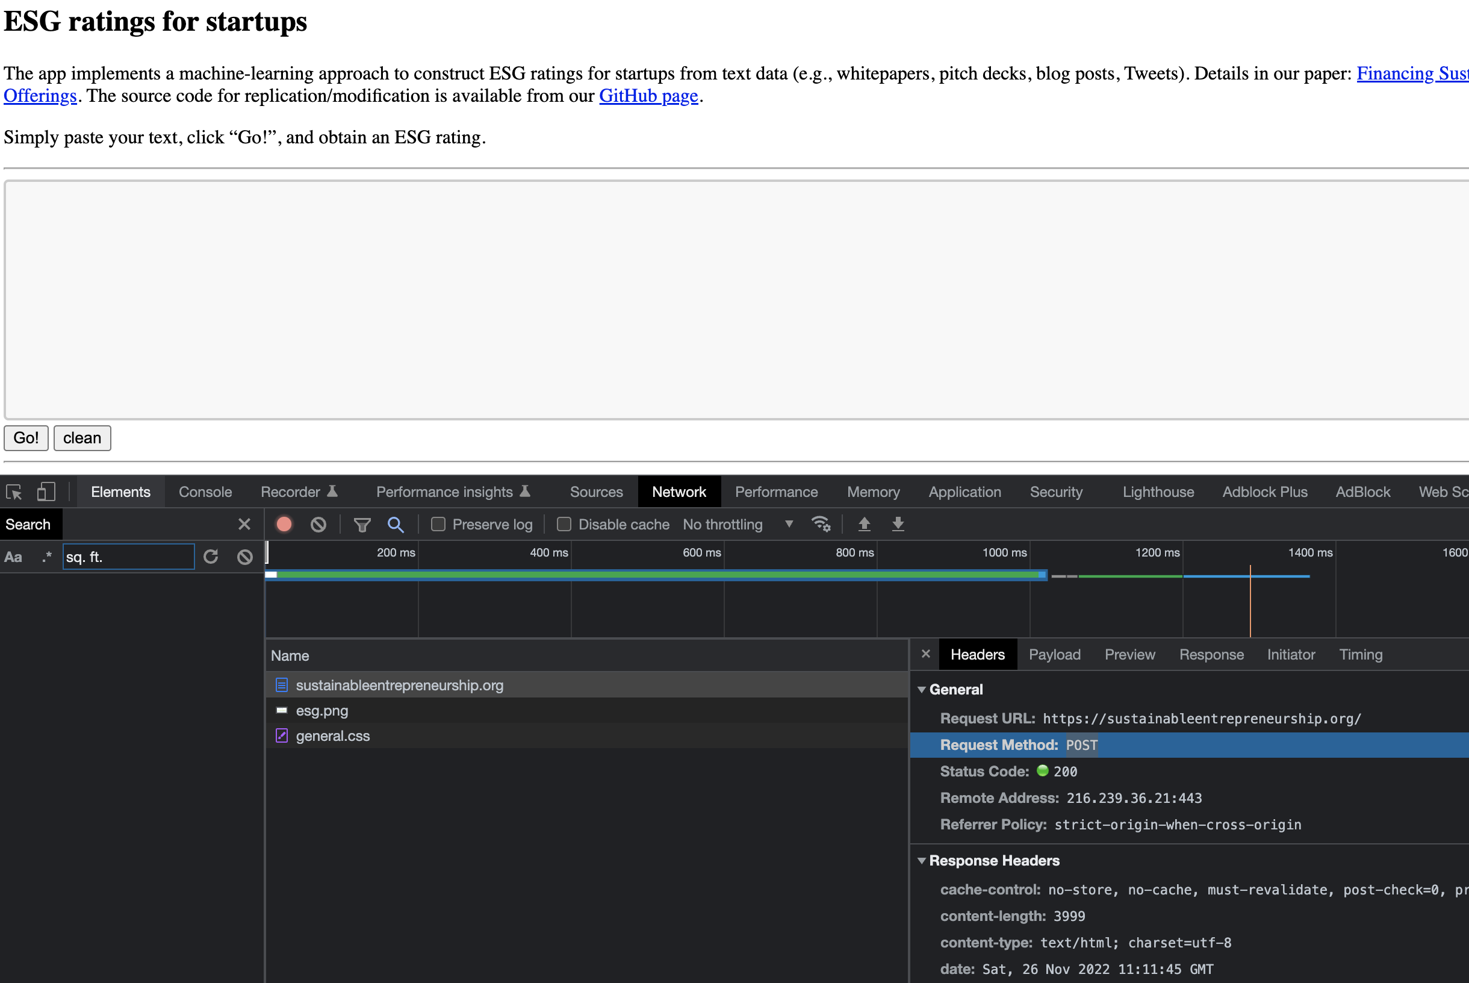
Example post request: https://sustainableentrepreneurship.org/
8
Notes:
Work with netword in chrome
Read json
Read wget
Maximum URL length is 2083 characters

Slide 9
APIs - Accessibility:
You discover the APIs, and find your way!
Some websites offer a nicely documented API to access their dataset
Example: Google products (Map, YouTube, Translate, …)
You need to apply for an API key
This could come with a cost based on your usage
Some websites create a “hub” by collecting many APIs in a single platform.
You may sacrifice some functionality to be more straightforward.
9
Notes:
Work with netword in chrome
Read json
Read wget

Slide 10
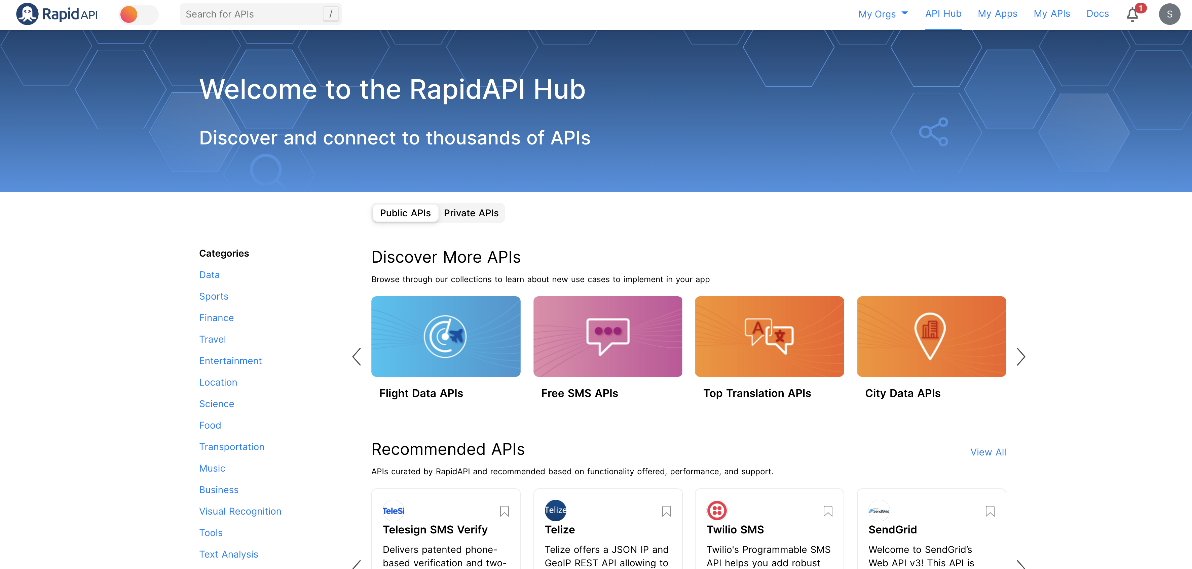
API hubs:
Rapidapi.com
10

Slide 11
Excercise:
Goal: We are interested in the most popular stocks in popular subs in Reddit:
https://www.reddit.com
Find a (rapid)API to get the list of stocks that were discussed in popular reddit stock and crypto subs
My suggestion: https://rapidapi.com/anjaneya2b/api/reddit-stock-and-crypto-tracker
What are the top ranked stocks?
What is the correlation between rank and mentions
Comparison between current rank and rank 24hrs ago
Which features should, in your opinion, correlates with rank more? Upvotes or Mentions
11

Slide 12

API hubs:
quandl.com
Documentations: https://data.nasdaq.com/tools/python
12

Slide 13
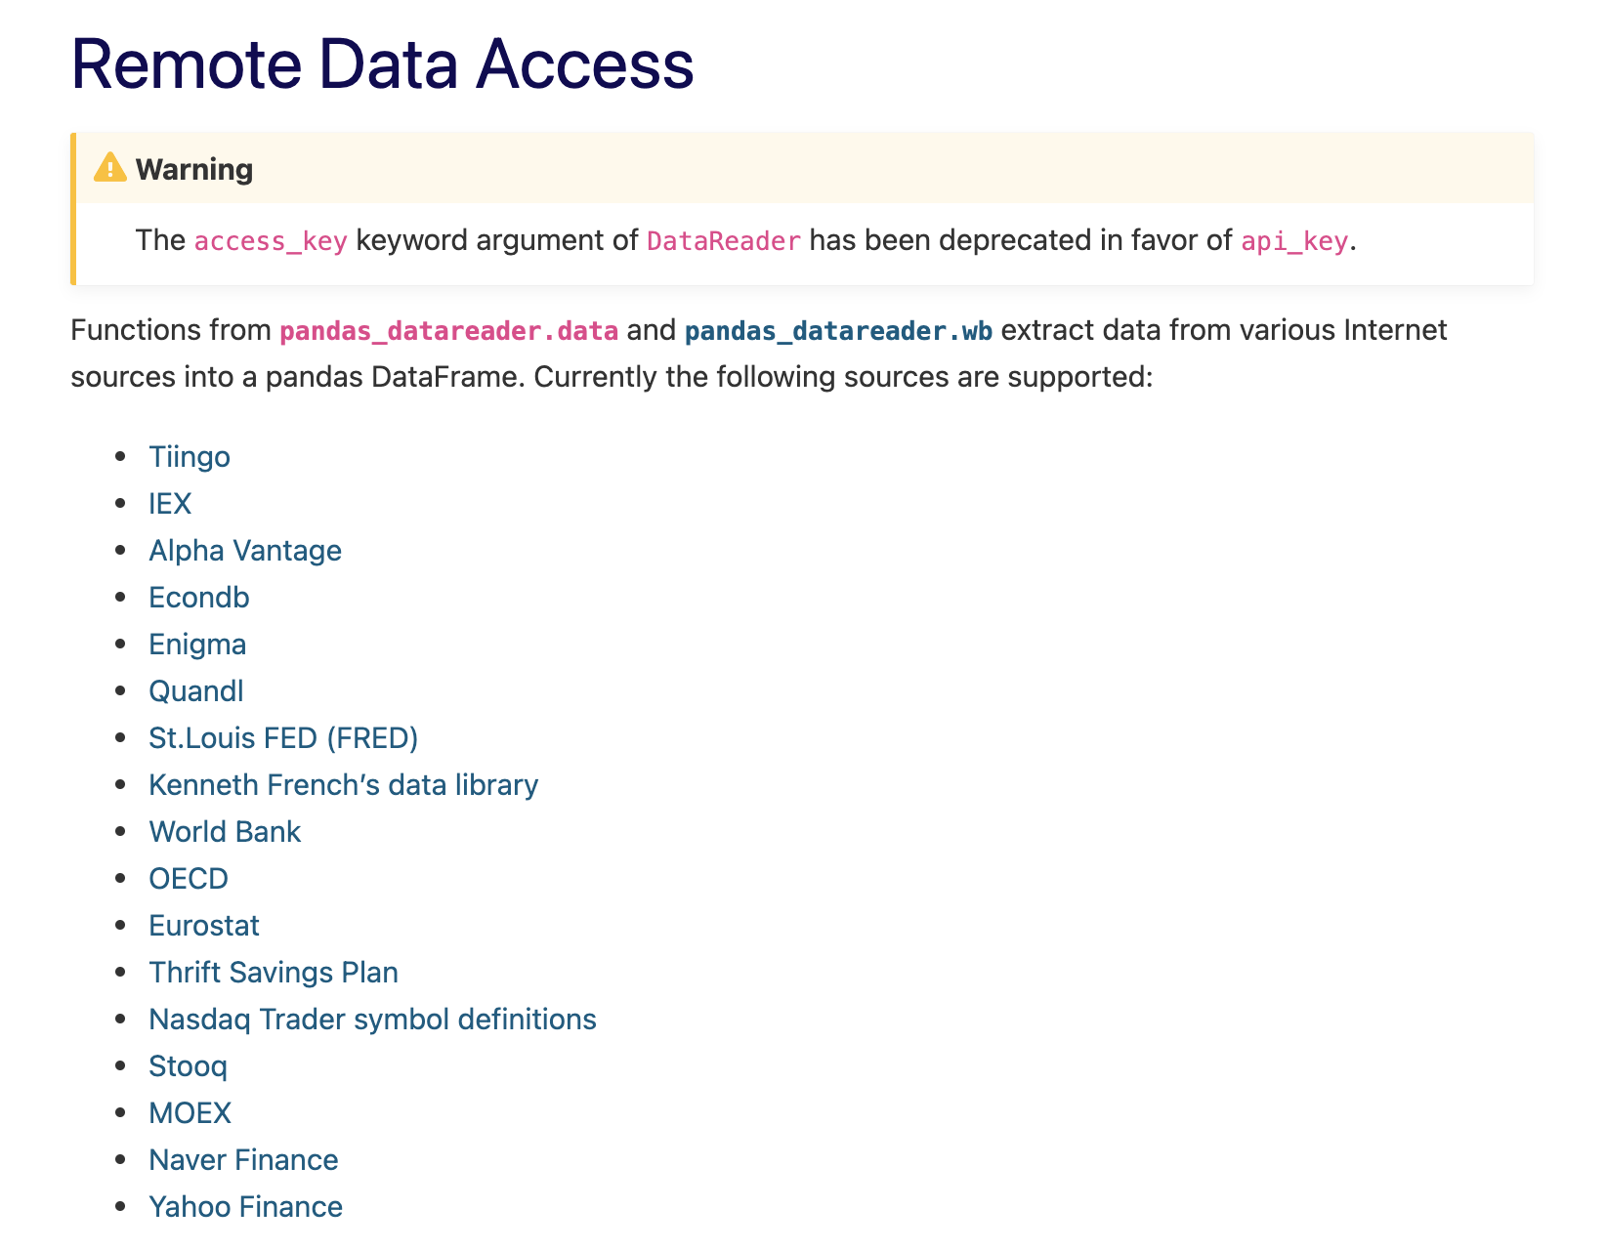
API hubs:
Pandas Datareader
13

Slide 14

Web scraping:
HTML
Easier Solutions:
Chrome extension (“web scraper”)
…
Beautiful Soup
Dealing with captcha
JavaScript
Selenium
PyAutoGUI
14

Slide 15
0. Ethics
Try to behave ethically!
Check and obey websites’ /robots.txt
If you scraping on behalf of your company, it could cost you a lot!
You may not be able to publish the results of your analysis, in fear of being sued!
Try not to crawl during the peak website traffic hours ()
Try not to parallel!
Put “sleeps” in the code.
15

Slide 16
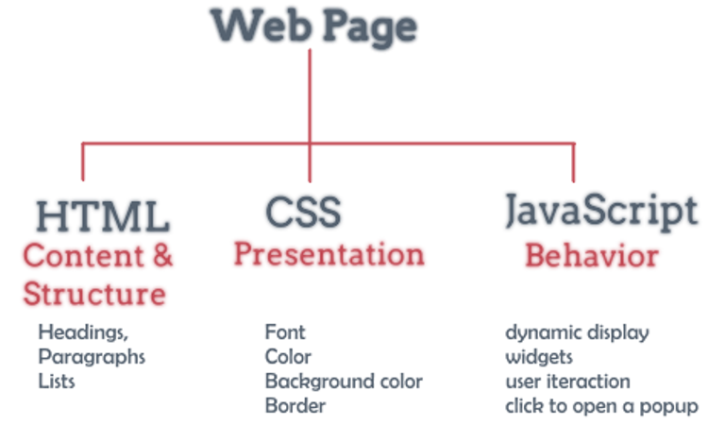
What is behind a website:
https://html-css-js.com/html/tags/
Source: https://www.10bestdesign.com/blog/learning-html--css--and-javascript/
16

Slide 17
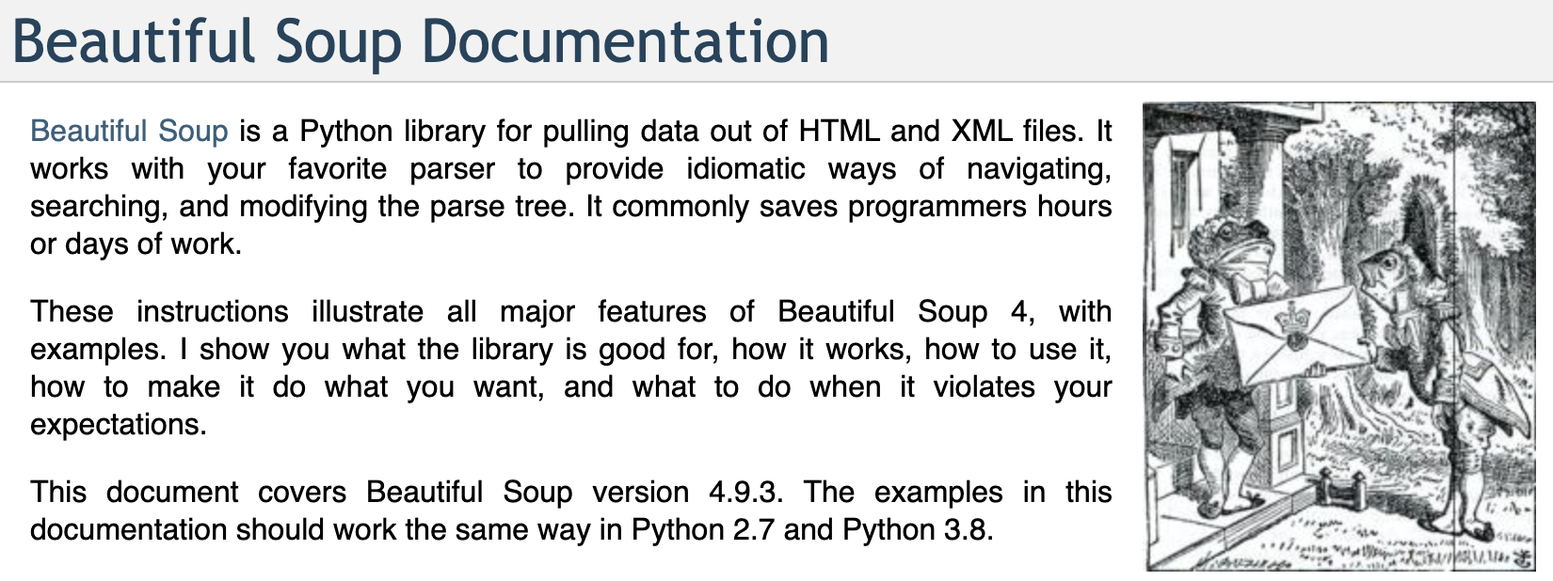
BeautifulSoup
https://www.crummy.com/software/BeautifulSoup/
17

Slide 18
Let’s practice
What is the average of IEO ratings on the ICObench.com?
What is the cumulative capital that IEO market raised?
Source: https://icobench.com/ieo
18

